Slide 1
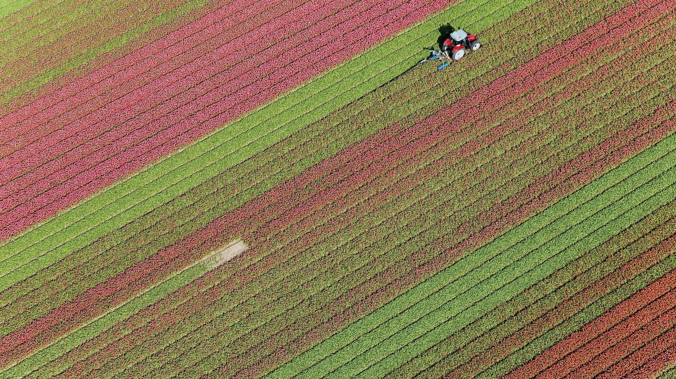
Killing Anxiety
Philippians 4:6-7
3rd Sunday
Feb. 16, 2025

Slide 2
And Jesus Christ preached – don’t be anxious . . . don’t be consumed by worry . . . look at the birds of the air – if your heavenly Father can take care of them – will He not take care of you? (Matthew 6:25)
In other words, if God has the power to create your life, He has the power to take care of your life. Yes, times have changed, but people haven’t. We might have refrigeration now and benefit packages and pharmacies on every other corner . . . but the ability to worry about a thousand things hasn’t changed.

Slide 3
Chapter 4: 4, Paul writes, “Rejoice in the Lord always; again I will say, rejoice. 5. Let your gentle spirit be known to all men. The Lord is near.
Make it your resolution to be joyful . . . make it your reputation to be a gentleman or a lady . . . and don’t forget – the Lord is near. And then a command – verse 6. Be anxious for nothing. Be anxious for nothing! This isn’t an option for Christians who are more mellow than others – for believers who are not so tightly wound or excitable or emotional. This is a command for every believer – and the first thing contained in this command is something Paul tells all of us to stop. Stop worrying.

Slide 4
Paul, perhaps more than anyone, knew that it doesn’t do you any good. Worry strangles your faith; it chokes off your praise; it throttles back your courage. It never builds you up – it only tears you down. And it doesn’t help you get ready for anything in life. If whatever you’re worried about happens, worry doesn’t prepare you for it; and if it doesn’t happen, worry robs you of the joy that it never happened. Worry is perhaps the greatest thief of the Christians joy – but to tell ourselves to quit worrying will never catch the thief. And that’s because worry is actually an inside job.

Slide 5
Notice the next phrase – be anxious for nothing – now notice, but in everything by prayer and supplication, with thanksgiving, let your requests be made known to God. Paul begins with this comprehensive negative – don’t worry about anything; and now this comprehensive positive – pray about everything. He doesn’t just tell us something to stop – he tells us something to start. And you have to do both. If you want to kill anxiety, you don’t just stop something, you have to start something. In fact, you have to do both of them or it will never work! So this is what you stop – the habit of worrying. And this is what you start – the practice of praying.

Slide 6
The first word is prayer:
This word is the general term for talking with God. It can happen anywhere at any time. But keep in mind that prayer is exclusively for Christians. All other prayers are exercises of piety with words that float no higher than the ceiling. Jesus Christ said in John 14:4, I am the way, the truth and the life – no man comes to the Father except through Me. That not only applies to living with God the Father, but talking to God the Father. Jesus is the only Mediator between the living Triune God and mankind (1 Timothy 2:5); Christ is the mediator of the new covenant (Hebrews 9:15).

Slide 7
The second word Paul uses is supplication:
Your translation might read petition. The word refers to praying with urgency about whatever issue it is that concerns you. Paul used the word in this letter already because he and the Philippian believers were going through the same struggle of suffering for their faith.
The third word Paul uses is request:
This word refers to simply bringing to the Lord any specific need you might have. And notice that your make your requests to God. He wants full disclosure from you. And in the giving of requests to Him you acknowledge openly your dependence entirely upon Him.

Slide 8
Paul writes – let your requests be made known to God – the preposition “to” – “to God” – pictures prayer as orienting you toward God. In other words, prayer refocuses the lens of life. We get so focused on things down here – prayer orients us back toward God; we get troubled or enamored or worried about stuff down here – prayer gets us reoriented to God up there. We get muddled on earth – prayer constantly reorients us to Heaven. Paul uses three words about prayer and then he makes one very important condition to overcoming worry – make all your prayers and supplications and requests with this attitude of thanksgiving!

Slide 9
Notice verse 7. And the peace of God, which surpasses all comprehension, will guard your hearts and your minds in Christ Jesus. And the peace of God – watch this – this peace – this serenity doesn’t come from you, it emanates from – it is sourced from the very character of God. And as you share with God every need and every request with surrendered thanksgiving, God shares with you His character – and in His character there is not one hint of worry or anxiety. So His peace becomes your peace. This peace is not natural, it is supernatural. Paul adds – it surpasses all comprehension.

Slide 10
So His peace becomes your peace. This peace is not natural, it is supernatural. Paul adds – it surpasses all comprehension. It transcends intellectual powers, human analysis, human insights and human understanding. It is superior to human scheming, human devices, and human solutions, since its source is the God whose judgments are unsearchable and whose ways are unfathomable (Romans 11:33). So the real challenge of the Christian life is not worrying about how to eliminate every unpleasant circumstance or even understand them; but how to trust your infinite, wise, powerful God.

